Slide 1
Decision Tree

Slide 2
Learning Outcomes
Evaluate the concept of decision trees and their usage for solving regression and classification problems
Assess the concepts that make up the decision tree work like Gini entropy, information gain, etc.

Slide 3
Applications of Decision Tree
Customer Relationship Management :- To classify the customers on their online behaviorals into specific groups.
Fraudulent statement decisions :- Auto classification of banking transactions if they are Fraudulent or not .
Energy Consumption :- How much energy will be consumed can be predicted in the next bill cycle
Healthcare Management :- In Medical diagnosis such as classifying patients whether the patients are diabetic /non diabetic , non pneumonia /pneumonia.

Slide 4
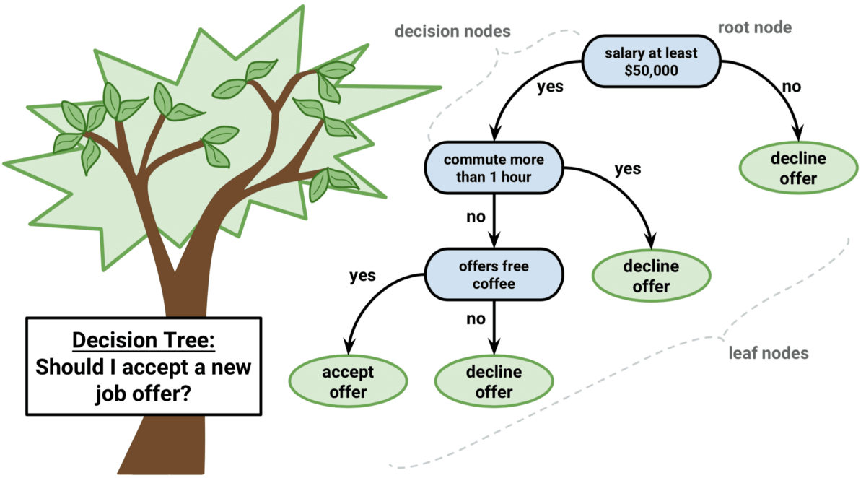
Decision Tree
A decision tree is a type of Supervised learning Algorithm in machine learning that are used to categorize or make predictions based on the previous set of rules.

Slide 5
Parametric Vs Non Parametric Algorithms
Decision tree is a Non Parametric algorithm .Let’s understand what is parametric and non parametric algorithms .
Parametric Algorithms
Non Parametric Algorithms
Parametric Algorithm are based on mathematical model which defines a relationship between input variables and output variables.
Example of Parametric Algorithms
Linear Regression
Logistic Regression
Neural Network
Non Parametric Algorithm tries to learn from the data itself and its patterns .They are computationally expensive .
Example of Non parametric Algorithms
Decision tree
KNN
Support Vector machine
Other Ensemble models like (XgBoost/AdaBoost/etc)

Slide 6
Decision tree
Decision trees are more effective in handling non linear data sets effectively.
There are two type of decision tree,Categorical variable and Continuous variable decision tree.
Decision tree provides a way to present algorithm with conditional control statements.

Slide 7
Types of Decision Tree
Categorical Variable decision
tree
Continuous Variable decision tree
A categorical variable decision tree will have target variable as an category the categories can be Binary or Multiclass.
A continuous variable decision tree will have target variable as Continuous in nature.
Example :- Yes/No , High/Medium/Low , Non Pneumonia/Pneumonia
Example:- Salary prediction, Demand Forecasting, Stock prediction.

Slide 8
CART ( Classification & Regression Tree)
Decision Tree Classifier
Decision Tree Regressor
Decision tree is popularly referred as the CART algorithm (Classification & Regression Trees)

Slide 9
Structure of Tree
Before we learn about decision tree algorithm let’s first understand Structure of Tree.
A
Root Node
A tree has nodes & branches
Branches connects nodes
There is a parent child relationships between the nodes connected with a branch (Node C is the child of Node A)
Depth of a node is defined as the number of branches from the node to the root node (Depth of node G is 2).
A node which has no child is called leaf node. (Nodes E, F, G and D are leaf nodes)
Branch
Decision Node
B
C
D
E
G
F
Leaf Node
Notes:
Decision trees always follows a top down approach meaning that the root node of the tree is on the top while the outcomes/prediction are represented by the tree leaves .

Slide 10
Make Decisions using Tree
Logic behind decision tree is to make decisions and continually split the dataset until Homogeneity.
For each question we will be adding a node in the tree and the first node is called the root node.
Asking questions based on the feature, splits the dataset resulting in a tree

Slide 11



Terminologies
Entropy :-In machine learning , entropy can be defined as a measure of the purity of sub split.Entropy always lies between 0 and 1 .Entropy of any split can be calculated as:
Gini Impurity :- Gini Impurity is somewhat similar to entropy in internal working .Both are used for building the tree using the best split.But there is quite difference in computational methods.
Information Gain :- Information gain tell us which is the best feature to split or best feature to use as root node for constructing a tree and then gradually create internal node and leaf node with each recursive split.

Slide 12
Let’s implement a Decision Tree classifier - 1
We will implement a decision tree using a small dataset, which has 4 features such as Loves popcorn, Loves soda,Age and Happy person and remember the Happy person is the target feature for the dataset.
Step 1: Select the feature which is going to be root node.
Loves Popcorn | Loves Soda | Age | Happy Person
Yes | Yes | 7 | No
yes | No | 12 | No
No | yes | 18 | yes
No | yes | 35 | yes
yes | yes | 38 | yes
yes | No | 50 | No
No | No | 83 | No
????

Slide 13
Let’s implement a Decision Tree classifier - 2
We will repeat the same process and we will fill all the leaf nodes recursively .
Select the feature as Loves Popcorn
Loves Popcorn | Loves Soda | Age | Happy Person
Yes | Yes | 7 | No
yes | No | 12 | No
No | yes | 18 | yes
No | yes | 35 | yes
yes | yes | 38 | yes
yes | No | 50 | No
No | No | 83 | No
Loves Popcorn
Yes
No
Yes = 1
NO=3
Yes = 2
No =1
Happy Person
Happy Person
Notes:
Likewise we will run down the remaining rows and will fill up the count where people loves or dislike popcorn and whether they are happy person or not.

Slide 14
Let’s implement a Decision Tree classifier – 3
We will do exact the same thing for the Loves Soda what we did for Loves Popcorn .And we will build simple tree given below
Loves Popcorn | Loves Soda | Age | Happy Person
Yes | Yes | 7 | No
yes | No | 12 | No
No | yes | 18 | yes
No | yes | 35 | yes
yes | yes | 38 | yes
yes | No | 50 | No
No | No | 83 | No
Now we will select the feature Loves Soda
Loves Soda
Yes
No
Yes =
NO=1
Yes =
NO=1
Happy Person
Happy Person
Notes:
We have to fill the bucket as per the data given above , if you observe carefully
The first row says person who loves Soda is not happy person we will increase the count under NO =1
The first row says person who does not loves Soda is not happy person we will increase the count under NO =1
Likewise we will keep track of all the records .

Slide 15
Let’s implement a Decision Tree classifier - 4
After we are done with the rows the below is the simple tree look like when we have Loves Soda attribute as an root node.
Loves Popcorn | Loves Soda | Age | Happy Person
Yes | Yes | 7 | No
yes | No | 12 | No
No | yes | 18 | yes
No | yes | 35 | yes
yes | yes | 38 | yes
yes | No | 50 | No
No | No | 83 | No
Loves Soda
Yes
No
Yes = 3
NO=1
Yes =0
NO=3
Happy Person
Happy Person

Slide 16
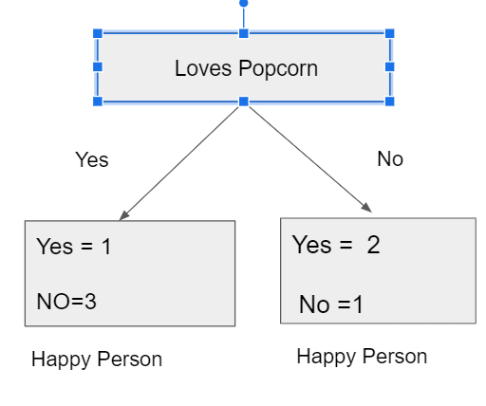
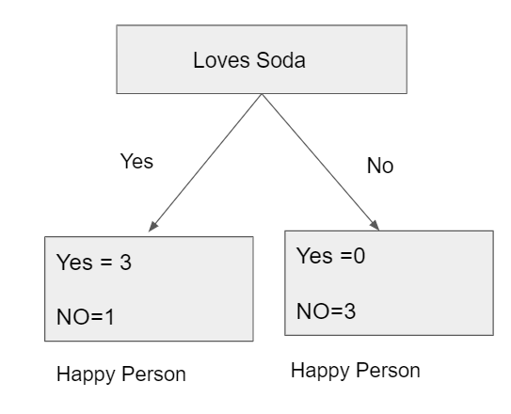
Let’s implement a Decision Tree classifier - 5
1
2
3
4
Note :- Both the tree where root node is Loves Popcorn and Loves Soda .They are not doing a perfect job in classifying who will be the happy person and who is not.
Leaf Node 1,2 & 3 does not have much purity and they are heterogeneous in nature whereas Leaf Node 4 has the purity .Our aim is to remove heterogeneity and keep homogeneity.

Slide 17
Let’s implement a Decision Tree classifier - 6
From the previous comparison between two simple tree. The Loves Soda tree is doing a better job in predicting person who will be happy or not . As the impurity there is in only one leaf but in the Loves popcorn tree we can see there are impurity in both the leaves.
Good News is there is always a way to measure/quantify the impurity in the leaves .Some methods are Entropy, Gini Impurity .Methodically they are same but they do differ in formulas.

Slide 18
Let’s implement a Decision Tree classifier - 7
We will be using Gini Impurity in this session to understand how we can calculate by formula . But we will also give the resources for Entropy as an post read.
We will start calculating the the gini impurity for all the individual leaves for the Loves popcorn tree
Gini impurity of left leaf = 1-(probability of “yes”)²-(probability of “No”)²
= 1-(1/1+3)²-(3/1+3)²
= 0.375
Gini impurity of right leaf = 1-(probability of “yes”)²-(probability of “No”)²
= 1- (2/2+1)²-(1/1+2)
= 0.444

Slide 19
Let’s implement a Decision Tree classifier - 8
Leaf on the left has 4 people in it
Leaf on the right has 3 people in it
As we can observe that leaves do not represent the same no of people. Thus to know the information gain ,to decide whether this feautre is best for root node we have to compute the weighted average of the Gini impurities for the leaves.

Slide 20
Let’s implement a Decision Tree classifier - 9
Thus the total Gini Impurity for all the leaves for
Total Gini impurity = Weighted average for Gini Impurities for the leaves.
Total G.I.= weighted gini avg for left leaf + weighted gini avg for right leaf
= (4/4+3) *0.375 + ( 3 / 4 + 3) *0.444
= 0.405
G.I.= 0.375
G.I.=0.444

Slide 21
Let’s implement a Decision Tree classifier - 10
Same method we will use to compute the weighted gini avg for the entire leaves for Love Soda .
Total Gini impurity = Weighted average for Gini Impurities for the leaves.
Total G.I.= weighted gini avg for left leaf + weighted gini avg for right leaf
= 0.214

Slide 22
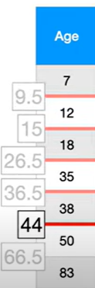
Let’s implement a Decision Tree classifier - 11
However because Age Contains numeric data, and not just Yes/No values .calculating the Gini Impurity is a little more involved .First the values has to be in ascending order and then compute the average age for all the adjacent peoples.
Loves Popcorn | Loves Soda | Age | Happy Person
Yes | Yes | 7 | No
yes | No | 12 | No
No | yes | 18 | yes
No | yes | 35 | yes
yes | yes | 38 | yes
yes | No | 50 | No
No | No | 83 | No

Slide 23
Let’s implement a Decision Tree classifier - 12
We will calculate the Gini Impurity values for each average age .Let’s show an example by selecting one of the average and see how we can compute gini impurity.
Age < 9.5
Loves Popcorn | Loves Soda | Age | Happy Person
Yes | Yes | 7 | No
yes | No | 12 | No
No | yes | 18 | yes
No | yes | 35 | yes
yes | yes | 38 | yes
yes | No | 50 | No
No | No | 83 | No
Average Age
7 +12 =9.5
12+18 =15
18+35 = 26.5
35+38 =36.5
38+50= 44
50+83= 66.5
Yes
No
Yes= 0
No =1
Yes=3
No=3
Happy Person
Happy Person

Slide 24
Let’s implement a Decision Tree classifier – 13
So the Gini Impurity would be :-
GI for a left leaf node = 1- (probability of “yes”)² - (probability of “No”)²
= 1-(0/0+1)²-(1/0+1)²
= 0
Age < 9.5
Yes
No
GI for a right leaf node =1-(probability of “yes”)² - (probability of“No”)²
= 1-(3/3+3)²- (3/3+3)²
= 0.5
Yes= 0
No =1
Yes=3
No=3
The weighted Gini Impurity for Age < 9.5 would be :- (1/1+6)*0 + (6/1+6)*0.5 = 0.429

Slide 25
Let’s implement a Decision Tree classifier - 14
Likewise we will be calculating all other Gini impurities for all other candidate values .
Avg Age | Gini Impurity
9.5 | 0.429
15 | 0.343
26.5 | 0.476
36.5 | 0.476
44 | 0.343
66.5 | 0.429
We can observe that low impurity for Avg Age 15 and 44 has the common lower impurity 0.343
In this case we will choose the
Avg Age 15 for a split.
Age < 15
Yes
No
No=2
Yes=0
No =2
yes=3
Happy Person
Happy Person

Slide 26
Let’s implement a Decision Tree classifier - 15
Loves Popcorn | Loves Soda | Age | Happy Person
Yes | Yes | 7 | No
yes | No | 12 | No
No | yes | 18 | yes
No | yes | 35 | yes
yes | yes | 38 | yes
yes | No | 50 | No
No | No | 83 | No
There is a simple battle among Loves Popcorn,Loves Soda and Age who is going to be the root node of the tree.
Where Happy Person is the Target variable.

Slide 27
Let’s implement a Decision Tree classifier - 16
Now we will compare the weighted gini impurity for all the attributes from the selection method measures .Which attribute will be the root node.
Loves Popcorn | Loves Soda | Age | Happy Person
Yes | Yes | 7 | No
yes | No | 12 | No
No | yes | 18 | yes
No | yes | 35 | yes
yes | yes | 38 | yes
yes | No | 50 | No
No | No | 83 | No
Weighted gini impurities as follows :-
Gini impurity for Loves Popcorn = 0.405
Gini impurity for Age < 15 = 0.343
Gini impurity for Loves Soda =0.214
We know that leaves has lowest impurity for Loves Soda.Hence we will select the Loves Soda as the root node of the final tree.

Slide 28
Let’s implement a Decision Tree classifier - 17
We will put Love Soda in the top as a root node and then we will try to construct a tree.
Loves Popcorn | Loves Soda | Age | Happy Person
Yes | Yes | 7 | No
yes | No | 12 | No
No | yes | 18 | yes
No | yes | 35 | yes
yes | yes | 38 | yes
yes | No | 50 | No
No | No | 83 | No
Loves Soda
yes
No
Yes = 3
No = 1
Yes = 0
No = 3
Happy Person
Happy Person
The right leaf is impure
The left leaf is pure and Homogeneous
Notes:
Then how to reduce the impurity .

Slide 29
Let’s implement a Decision Tree classifier - 18
As we can observe that in the Left Node there is impurity to reduce the impurity we will have to go one more levels or we can say more set of questions to reduce impurity in the leafs .
Lets see if we can reduce the impurity by splitting the people that loves Soda based on Loves Popcorn and age .
Loves Soda
yes
No
Yes = 3
No = 1
Yes = 0
No = 3
Happy Person
Happy Person
Loves popcorn
Age<??

Slide 30
Let’s implement a Decision Tree classifier - 19
Loves Soda
Loves Popcorn | Loves Soda | Age | Happy Person
Yes | Yes | 7 | No
yes | No | 12 | No
No | yes | 18 | yes
No | yes | 35 | yes
yes | yes | 38 | yes
yes | No | 50 | No
No | No | 83 | No
yes
No
Yes = 3
No = 1
Yes = 3
No = 0
Happy
Person
Happy
Person
Loves PopCorn
Age <???
vs
Yes = 1
No = 1
Yes=2
No=0
Total Gini Impurity = 0.25
Happy
Person
Happy
Person
Notes:
In this slide we will see the weighted gini impurity , where Love Soda -> Loves Popcorn -> 0.25 . and now we will see Loves Soda -> Age < -> ? gini impurity would be .

Slide 31
Let’s implement a Decision Tree classifier - 20
Loves Soda
Loves Popcorn | Loves Soda | Age | Happy Person
Yes | Yes | 7 | No
yes | No | 12 | No
No | yes | 18 | yes
No | yes | 35 | yes
yes | yes | 38 | yes
yes | No | 50 | No
No | No | 83 | No
We will calculate the average age for those people who Loves Soda and its yes.
7+18= 12.5
18+35= 26.5
35 + 38 = 36.5
yes
No
Yes = 3
No = 1
Yes = 3
No = 0
Happy
Person
Happy
Person
Loves PopCorn
Age <???
Gini Impurity = 0.25
Notes:
We will see people Loves Soda

Slide 32
Let’s implement a Decision Tree classifier – 21
Loves Soda
Over here we will take the Lowest impurity for Avg Age < 12.5 and will try to construct leaves for that node.
Yes
No
Loves Popcorn | Loves Soda | Age | Happy Person
Yes | Yes | 7 | No
yes | No | 12 | No
No | yes | 18 | yes
No | yes | 35 | yes
yes | yes | 38 | yes
yes | No | 50 | No
No | No | 83 | No
Yes = 3
No = 1
Yes = 3
No = 0
Happy
Person
Happy
Person
Age <12.5
Loves PopCorn
Yes
No
Gini Impurity = 0.25
Yes=0
No=1
Yes=3
No=0
Happy
Person
Happy
Person
Notes:
If you compare the leaf node while we select Loves Popcorn as an decision node there is impurity but when we select another attribute Age < 12.5 as a decision node for split then we see no impurity and they are homogenous . The Gini Score is 0.

Slide 33
Let’s implement a Decision Tree classifier - 22
Now, we will finalise the Age , as an internal node , person who loves soda and age < 12.5 can achieve impurity in the leaf nodes.
Loves Soda
Loves Popcorn | Loves Soda | Age | Happy Person
Yes | Yes | 7 | No
yes | No | 12 | No
No | yes | 18 | yes
No | yes | 35 | yes
yes | yes | 38 | yes
yes | No | 50 | No
No | No | 83 | No
Yes
No
Age <12.5
Yes=0
No =3
Yes
No
Yes= 0
No=1
Yes=3
No= 0
Notes:
Thus we have reached the final destination of the constructing the final and optimal Tree.

Slide 34
Let’s implement a Decision Tree classifier - 23
Once we are done with building the optimal tree we will now assign the labels to the output leaf.
We need to assign each leaf Happy person or not happy person as per the majority of yes/no in the leaf nodes.
Loves Soda
Yes
No
Age <12.5
Yes=0
No =3
Yes
Not Happy person
No
Yes= 0
No=1
Yes=3
No= 0
Not Happy person
Happy person

Slide 35
Final Tree
Loves Soda
Yes
No
Age <12.5
Not Happy person
Yes
No
Not Happy person
Happy person

Slide 36
Prediction of new data point.
Below table shows new data provided to decision tree, Let's see how decision tree will work
Loves Soda
Loves Popcorn | Loves Soda | Age | Happy Person
Yes | yes | 15 | ???
Yes
No
Age <12.5
Not Happy person
On this very information, if we want to predict whether the person will be happy/not .
Yes
No
Not Happy person
Happy person
Notes:
In this case the person would be Happy Person. Because people who loves Soda and age greater than 12.5 will be a Happy Person.

Slide 37
Quiz Poll
1. What are the metrics to measure the impurities of a decision tree classifier?
Entropy
Gini index
Both I & II above
Standard deviation reduction.
2. Suppose a dataset consist of 4 features where 3 features are predictors and another feature is Target variable .Now suppose if we have to select a feature as root node , then will it be an arbitrarily selection feature ?
Yes
No
3. What will be the node that we will be calling in a decision tree where there will be no further split is going to be?
Root node
Terminal node
Decision node
Branch Node

Slide 38
Quiz Poll
4. Assume in a dataset ,we have 4 features out of those one feature is continuous variable . In process of selecting the root node we have to compute the gini index for each variables. So when it comes to continuous variable how the gini impurity will be calculated ?
Taking account of the continuous variable.
Halving the records and then compute the gini impurity.
Taking 70% , 30% records of the cont. variable and compute gini impurity.
Taking average of two points in consecutive manner and then compute gini impurity.
5. Let’s say you have built three decision tree on a small dataset dtree1 with max_depth 2 , dtree 2 with max_depth 5 and dtree 3 with max_depth 8 .which trees is more likely to overfit ?
Dtree 1
Dtree 2
Dtree 3
None

Slide 39
Demo

Slide 40
Decision Tree: Regression

Slide 41
Decision Tree Regression Vs Linear Regression
Linear data & Non linear data
85
85
84
Marks
72
Vs
65
65
62.7
64
Marks
62
55
45
47
45
44
Hours spent
Hours spent
A
B
Notes:
In the first picture A , we can surely fit a line to predict the Marks obtained from the Hours spent data ,But in the Picture B a linear straight line will not be a good idea to fit

Slide 42
Prediction in Linear Data
85
If we want to predict what would be the marks obtained when a student has spent around 6 hours .This becomes easy to predict by a straight line because the nature of the data is linear and the prediction is accurate.
72
Marks
65
62.7
55
45
Hours spent
A

Slide 43
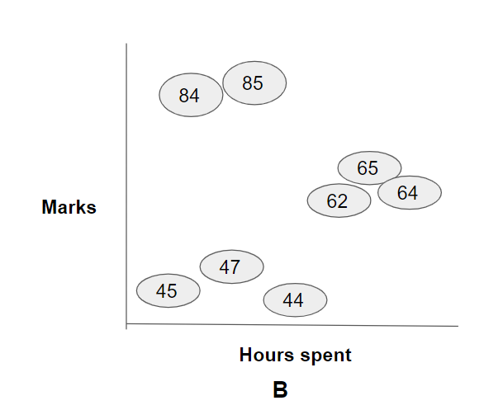
Prediction in Non Linear data
Predicting with straight line will be a big problem over here as data patterns are spread into clusters . if someone studying 6 hours a day will get average marks around 64 as per the straight line But in reality it should be around 84.5.
So in this scenario to make assumptions with a straight line will be a bad idea .Regression trees will be the best option to handle this shortfalls

Slide 44
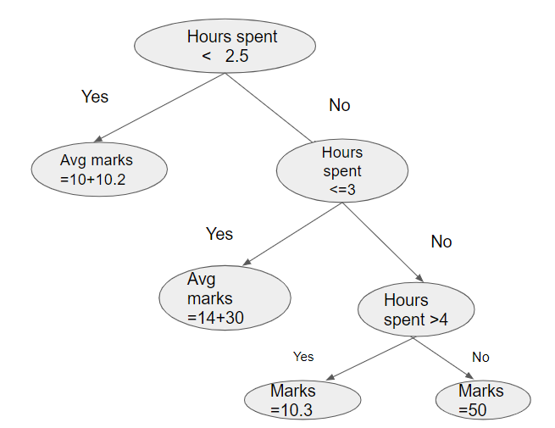
How prediction works in Decision Tree Regression - 1
Let’s say a student spends 2.7 hours in studying what could his/her expected marks would be?
Based on the diagram, we can see that when hours spent is > 2.5 and in the next level if hours spent is <=3 the output avg marks of ( 14+30) =22

Slide 45
How prediction works in Decision Tree Regression - 2
Hours spent < 2.5
Hours Spent | Marks Secured
2 | 10
2.1 | 10.2
2.5 | 14
3 | 30
4 | 50
6 | 10.3
Yes
No
Avg marks =10+10.2
Hours spent <=3
Yes
No
Avg marks =14+30
Hours spent >4
Yes
No
Marks =10.3
Marks=50
Notes:
If we ask these set of question then probably regression tree can helps to predict any numerical continuous data . Now the prediction would be the average of all the points within the specific conditions .
Note :- This is just an example to show how a regression tree splits and create numeric leaf nodes based on certain conditions.From the next slide we will be able to discuss the intuition and the calculation behind it how we can create internal nodes and decision nodes.

Slide 46
Decision Tree Regression Algorithm
Assume we have one predictor feature X and target variable Y .
First it will take two samples from feature X and average them .Then we will split the samples by the condition less than/ greater than the average which will have some samples left and right.
We will compute the average of all the samples for the left leaf node and all the samples for the right leaf node. We will compute the sum of squared residuals combinedly for left and right leaf node.
Step 2 to 3 is recursive until we get the least sum of squared residual for the individual split.
Once we get the split having least sum of squared residual we will select that split as the root node .
Then we will try to find again for optimal split of all the left and right samples keeping the first split as root node to find next decision node or further split.
Our aim is to find the leaf nodes which will have less variance between samples.
Notes:
A cursory steps has been written in points .The mechanism follows afte this slide

Slide 47
Quiz Poll
1. Pick the scenario which will be best for the Decision tree regression.
Mark secured by student wrt hours they spent in studying.
Weight measure wrt hours they spent in gym.
Customer retention on spending behavioral
House sale prediction
2. What is the measure/criteria to be used to construct a decision tree regression .
Gini Index
Entropy
Information gain
Standard deviation reduction

Slide 48
Demo

Slide 49
Summary
Understanding the concepts of Decision Tree
Understanding Decision Tree with Classification
Understanding Decision Tree with Regression

